Slide 1
Distributed Systems:
Principles and Paradigms
By Andrew S. Tanenbaum
and Maarten van Steen

Slide 2
Outline
Introduction
Communication
Processes
Naming
Synchronization
Consistency and Replication
Fault Tolerance
Security
Distributed Object-based Systems
Distributed File Systems
Distributed Document-based systems
Distributed Coordination-based Systems

Slide 3
Introduction
Chapter 1

Slide 4
Definition of a Distributed System (1)
A distributed system is:
A collection of independent computers that appears to its users as a single coherent system

Slide 5
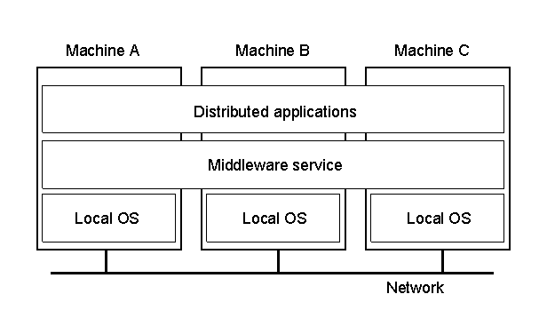
Definition of a Distributed System (2)
1.1
A distributed system organized as middleware
Note that the middleware layer extends over multiple machines

Slide 6
Transparency in a Distributed System
Transparency | Description
Access | Hide differences in data representation and how a resource is accessed
Location | Hide where a resource is located
Migration | Hide that a resource may move to another location
Relocation | Hide that a resource may be moved to another location while in use
Replication | Hide that a resource may be shared by several competitive users
Concurrency | Hide that a resource may be shared by several competitive users
Failure | Hide the failure and recovery of a resource
Persistence | Hide whether a (software) resource is in memory or on disk
Different forms of transparency in a distributed system

Slide 7
Scalability Problems
Concept | Example
Centralized services | A single server for all users
Centralized data | A single on-line telephone book
Centralized algorithms | Doing routing based on complete information
Examples of scalability limitations

Slide 8
Scaling Techniques
Hiding communication latencies
Distribution
Replication

Slide 9
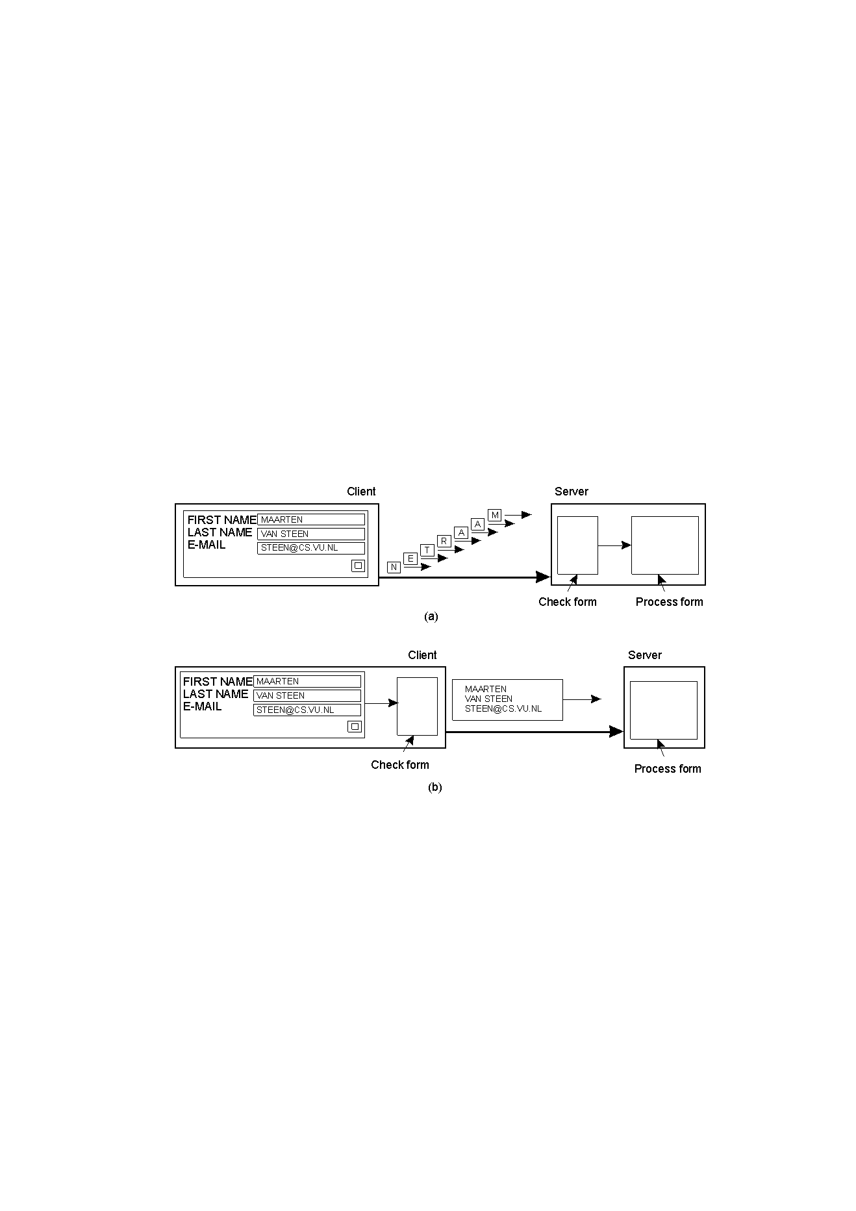
Scaling Techniques (1)
1.4
The difference between letting:
a server or
a client check forms as they are being filled

Slide 10
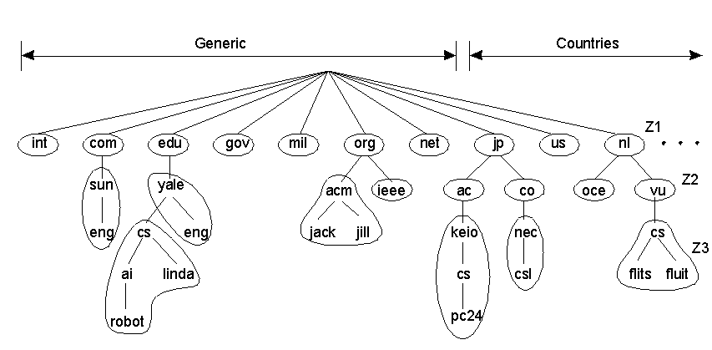
Scaling Techniques (2)
1.5
An example of dividing the DNS name space into zones

Slide 11
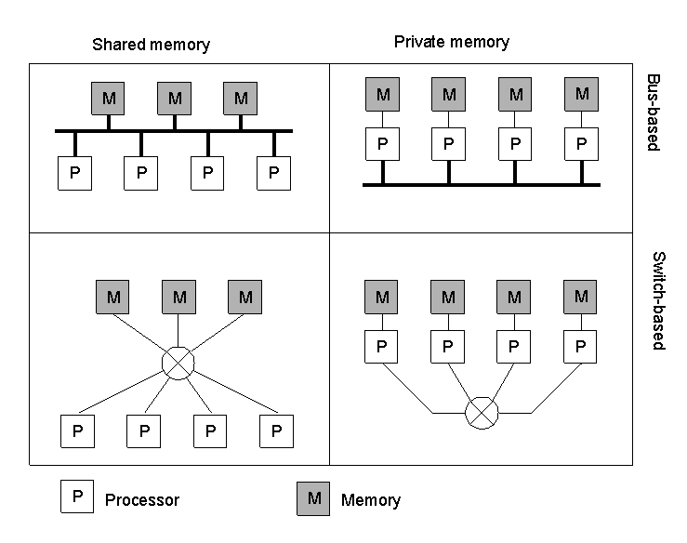
Hardware Concepts
1.6
Different basic organizations and memories in distributed computer
systems

Slide 12
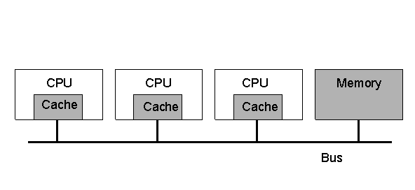
Multiprocessors (1)
1.7
A bus-based multiprocessor

Slide 13
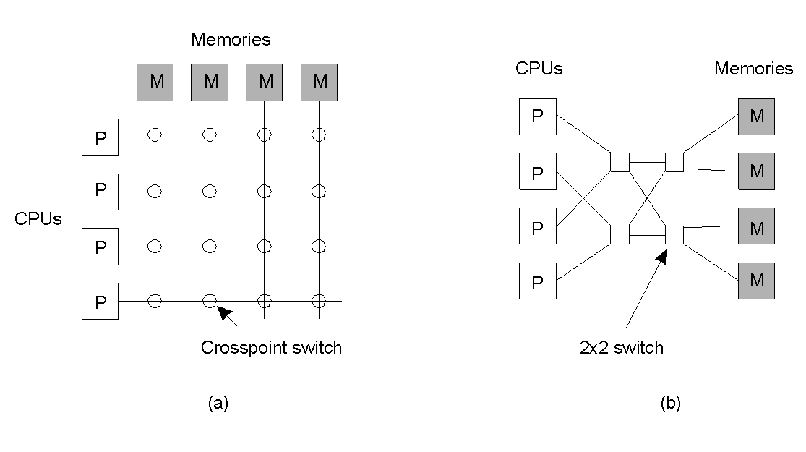
Multiprocessors (2)
1.8
A crossbar switch
An omega switching network

Slide 14
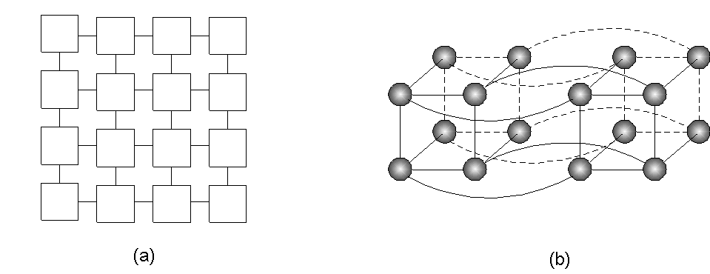
Homogeneous Multicomputer Systems
1-9
Grid
Hypercube

Slide 15
Software Concepts
System | Description | Main Goal
DOS | Tightly-coupled OS for multi-processors and homogeneous multicomputers | Hide and manage hardware resources
NOS | Loosely-coupled OS for heterogeneous multicomputers (LAN and WAN) | Offer local services to remote clients
Middleware | Additional layer atop of NOS implementing general-purpose services | Provide distribution transparency
An overview of
DOS (Distributed Operating Systems)
NOS (Network Operating Systems)
Middleware

Slide 16
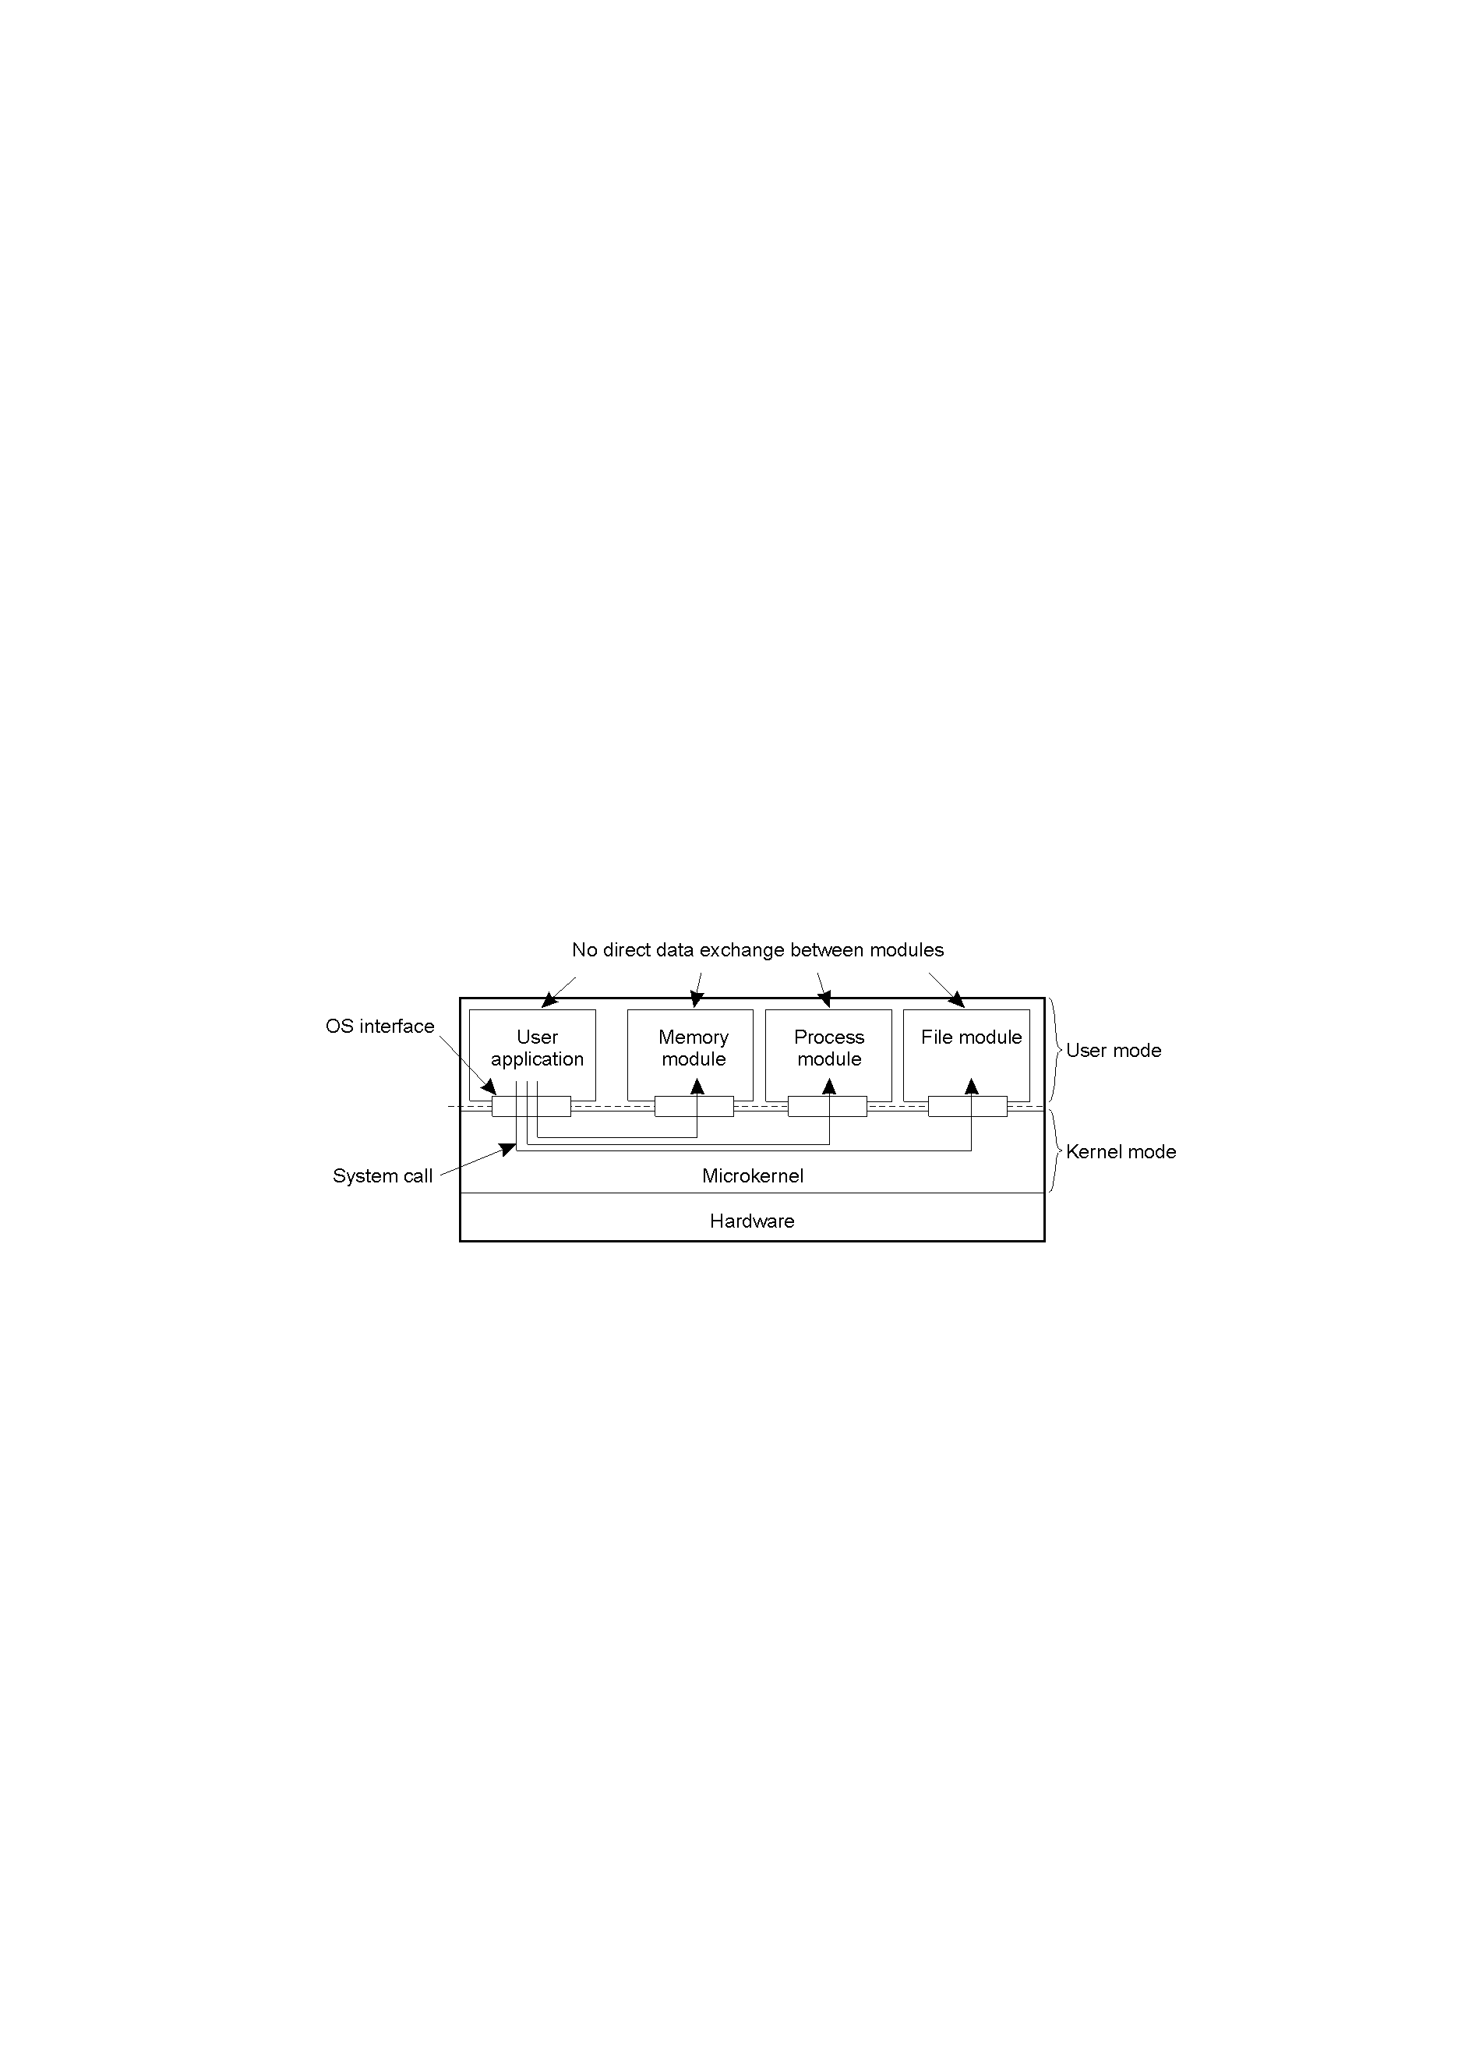
Uniprocessor Operating Systems
1.11
Separating applications from OS code through
a microkernel

Slide 17
Multiprocessor Operating Systems (1)
monitor Counter {
private:
int count = 0;
public:
int value() { return count;}
void incr () { count = count + 1;}
void decr() { count = count – 1;}
}
A monitor to protect an integer against concurrent access

Slide 18
Multiprocessor Operating Systems (2)
monitor Counter {
private:
int count = 0;
int blocked_procs = 0;
condition unblocked;
public:
int value () { return count;}
void incr () {
if (blocked_procs == 0)
count = count + 1;
else
signal (unblocked);
}
void decr() {
if (count ==0) {
blocked_procs = blocked_procs + 1;
wait (unblocked);
blocked_procs = blocked_procs – 1;
}
else
count = count – 1;
}
}
A monitor to protect an integer against concurrent access,but
blocking a process

Slide 19
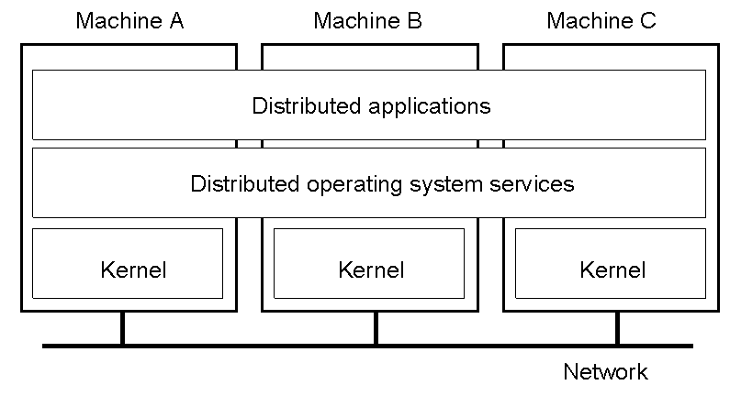
Multicomputer Operating Systems (1)
1.14
General structure of a multicomputer operating system

Slide 20
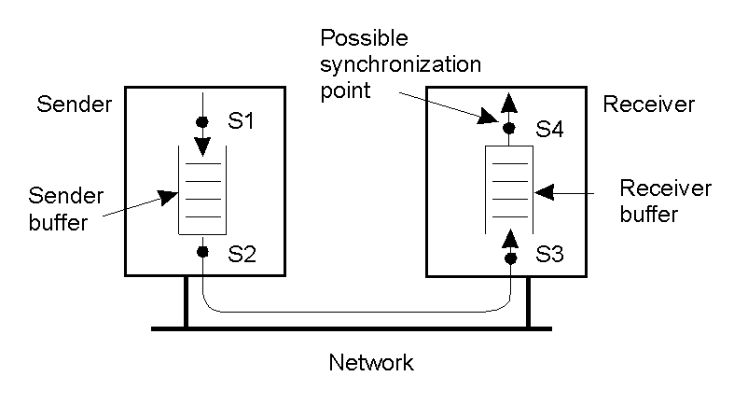
Multicomputer Operating Systems (2)
1.15
Alternatives for blocking and buffering in message passing

Slide 21
Multicomputer Operating Systems (3)
Synchronization point | Send buffer | Reliable comm. guaranteed?
Block sender until buffer not full | Yes | Not necessary
Block sender until message sent | No | Not necessary
Block sender until message received | No | Necessary
Block sender until message delivered | No | Necessary
Relation between blocking, buffering, and reliable communications

Slide 22
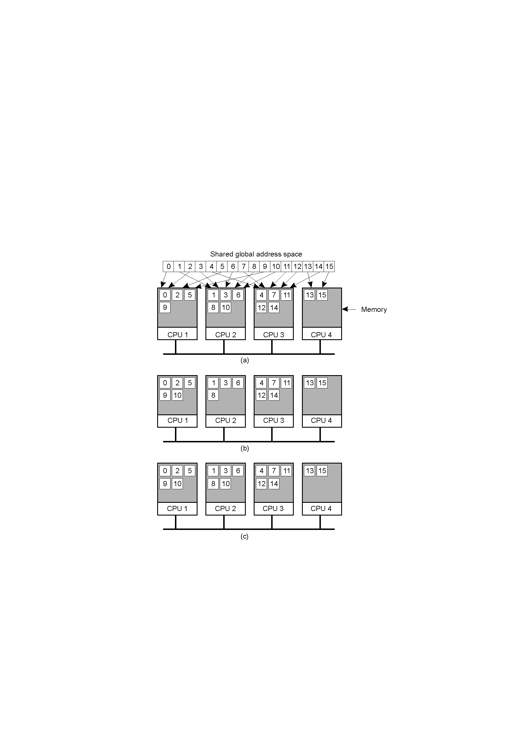
Distributed Shared Memory Systems (1)
Pages of address space distributed among four machines
Situation after CPU 1 references page 10
Situation if page 10 is read only and replication is used

Slide 23
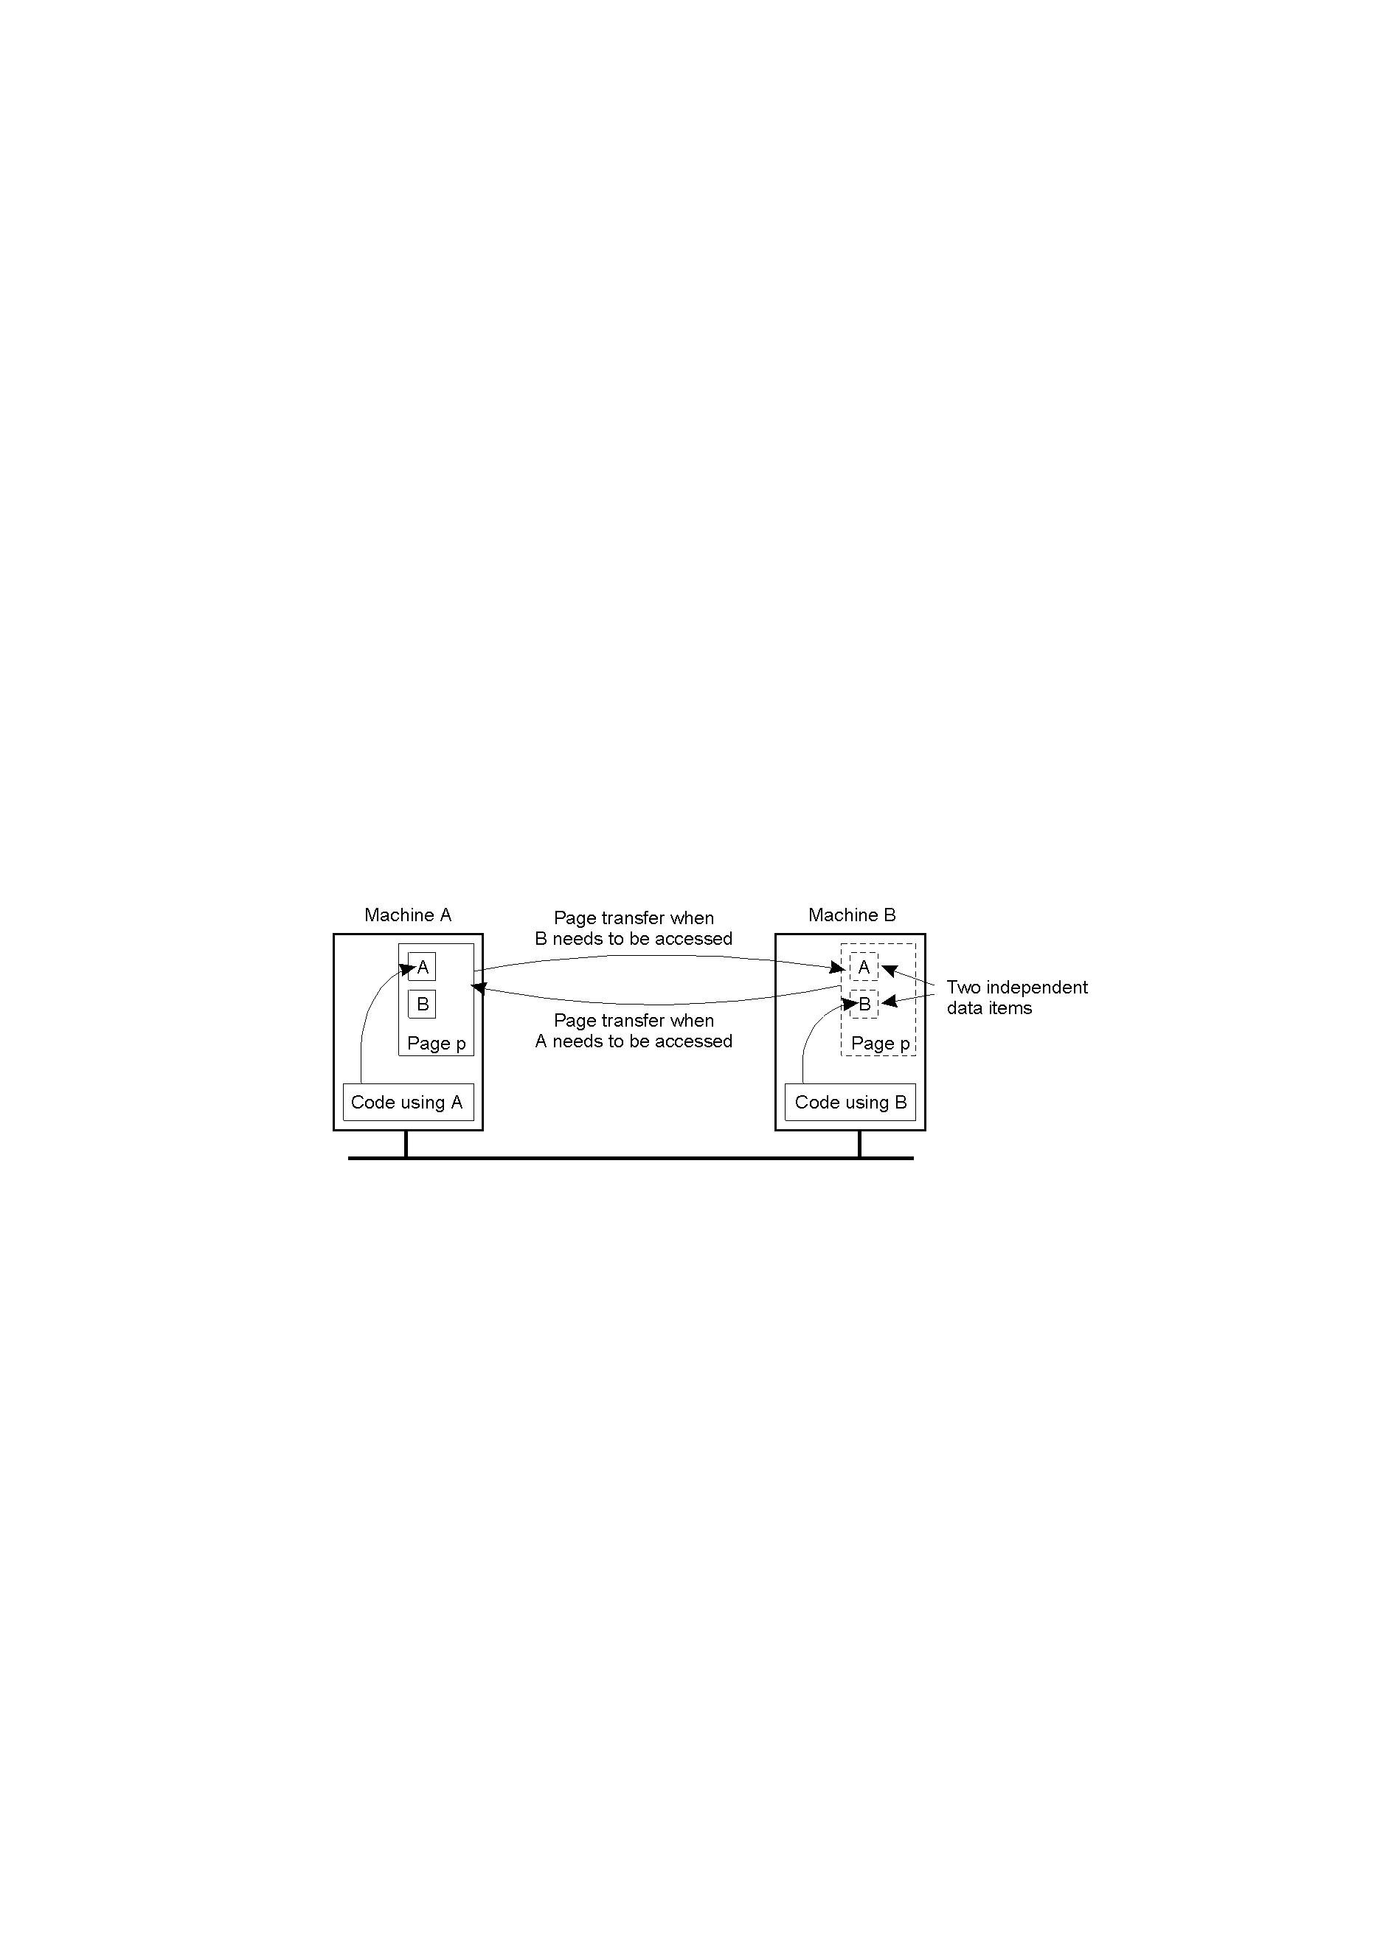
Distributed Shared Memory Systems (2)
1.18
False sharing of a page between two independent processes

Slide 24
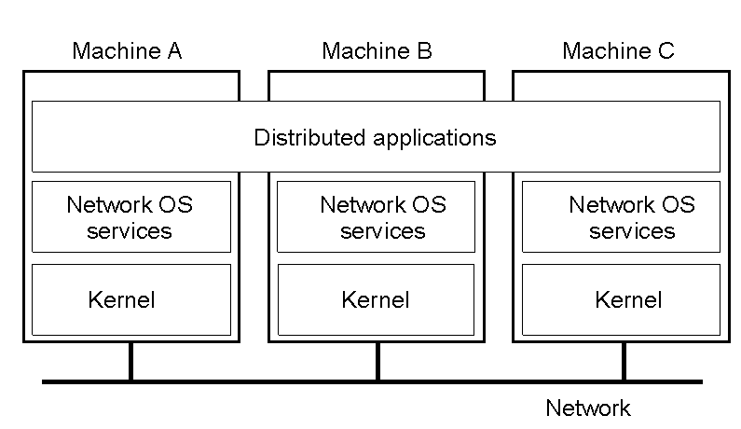
Network Operating System (1)
1-19
General structure of a network operating system

Slide 25
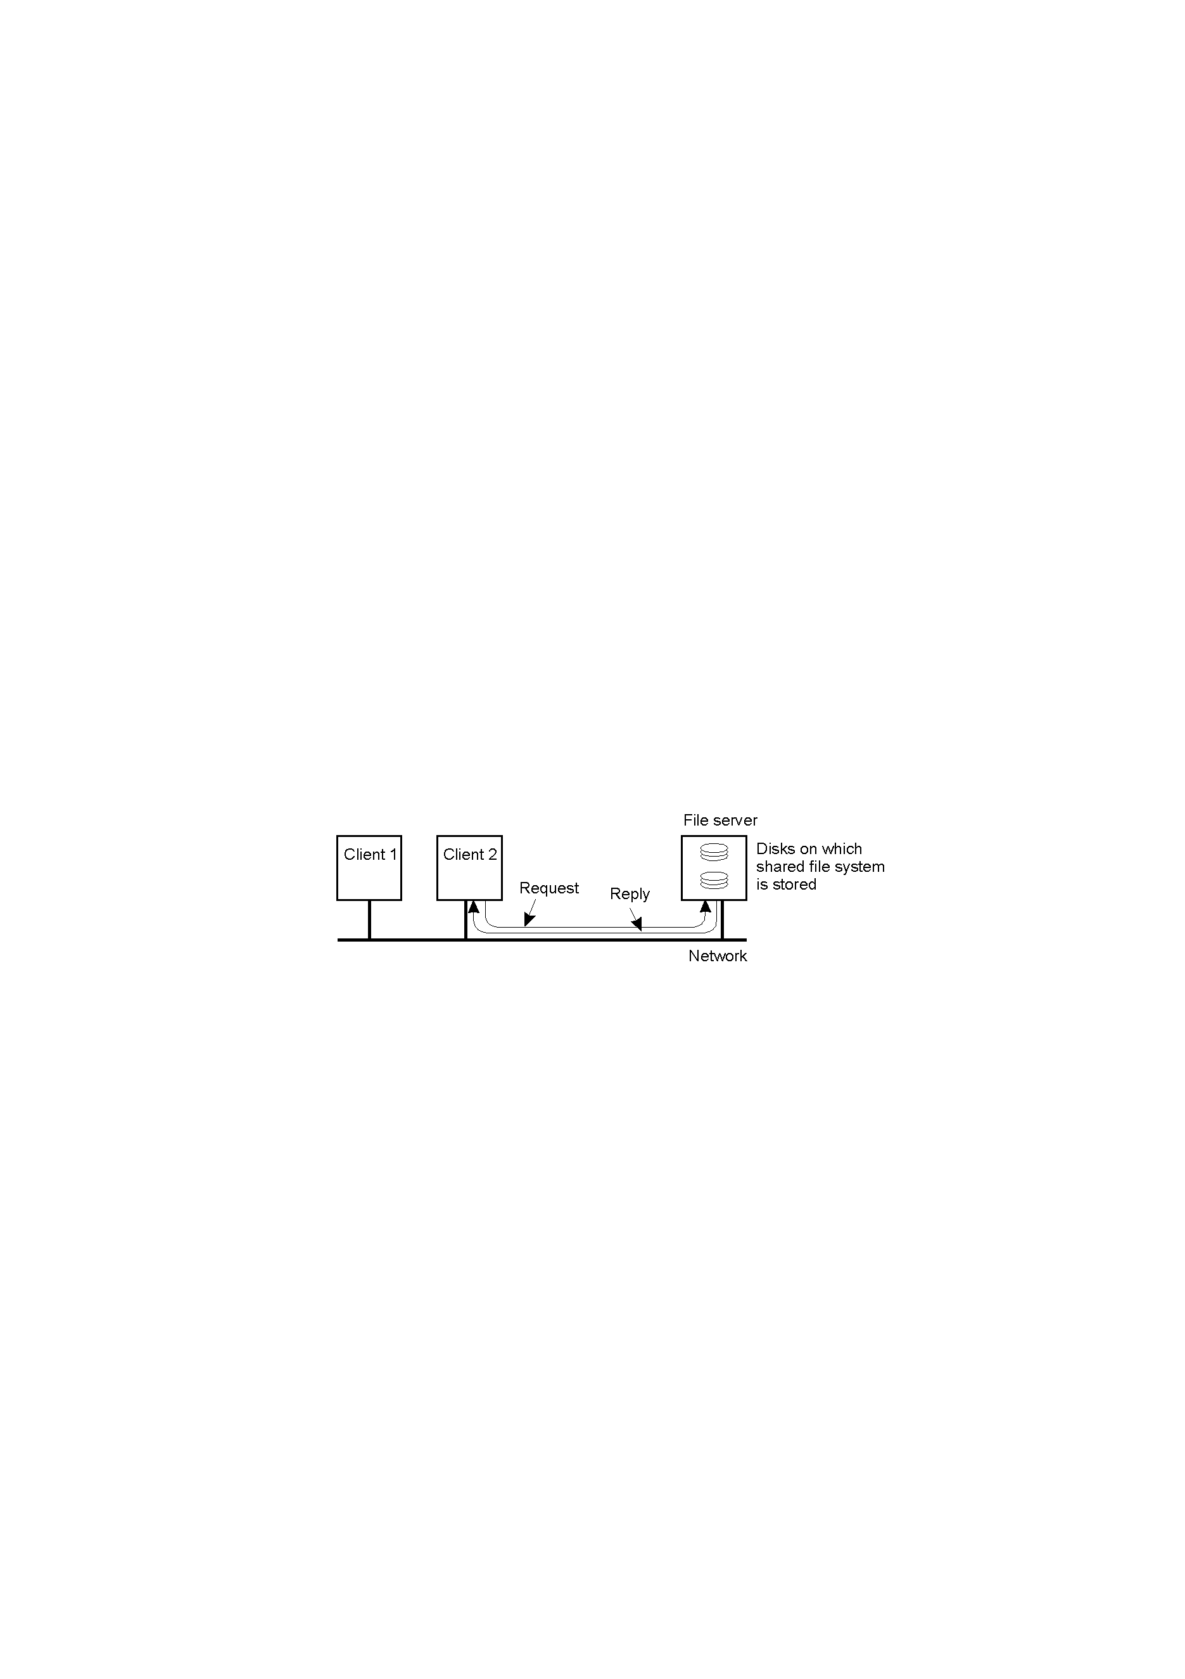
Network Operating System (2)
1-20
Two clients and a server in a network operating system

Slide 26
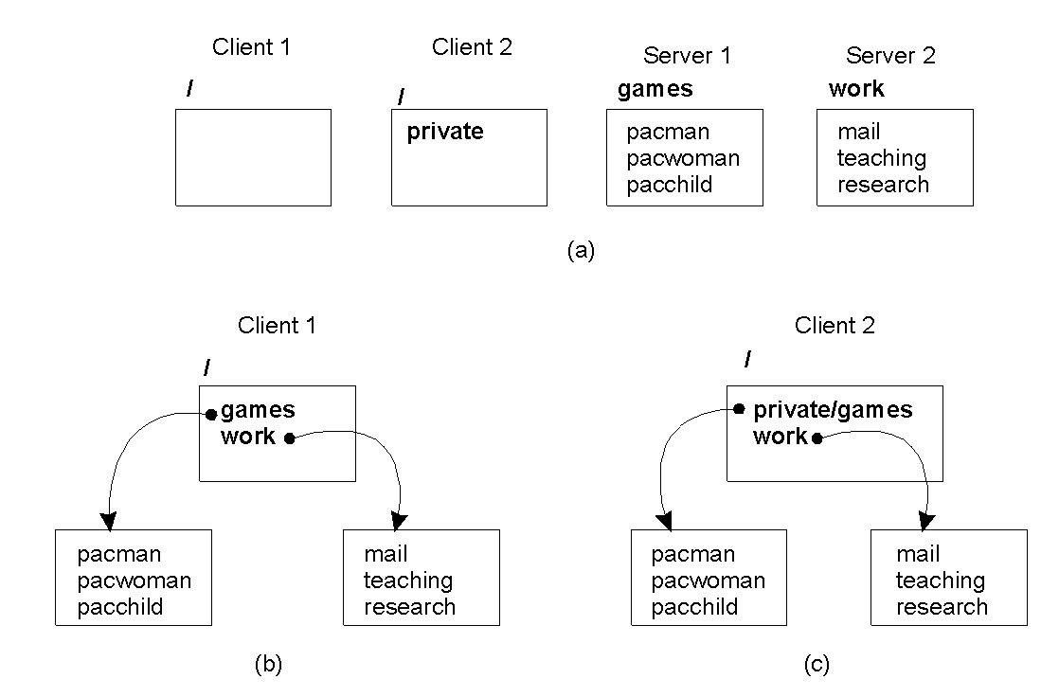
Network Operating System (3)
1.21
Different clients may mount the servers in different places

Slide 27

Positioning Middleware
1-22
General structure of a distributed system as middleware

Slide 28

Middleware and Openness
1.23
In an open middleware-based distributed system, the protocols used by each middleware layer should be the same, as well as the interfaces they offer to applications

Slide 29
Comparison between Systems
Item | Distributed OS |  | Network OS | Middleware-based OS
 | Multiproc. | Multicomp.
Degree of transparency | Very High | High | Low | High
Same OS on all nodes | Yes | Yes | No | No
Number of copies of OS | 1 | N | N | N
Basis for communication | Shared memory | Messages | Files | Model specific
Resource management | Global, central | Global, distributed | Per node | Per node
Scalability | No | Moderately | Yes | Varies
Openness | Closed | Closed | Open | Open
A comparison between multiprocessor OS, multicomputer OS, network OS, and middleware based distributed systems

Slide 30
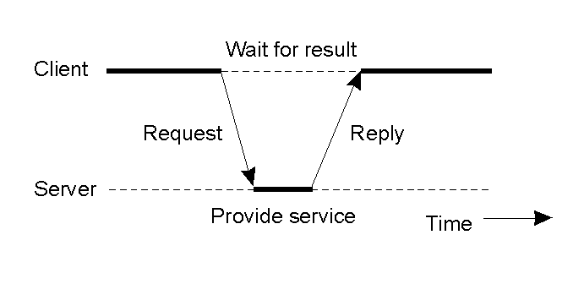
Clients and Servers
1.25
General interaction between a client and a server

Slide 31
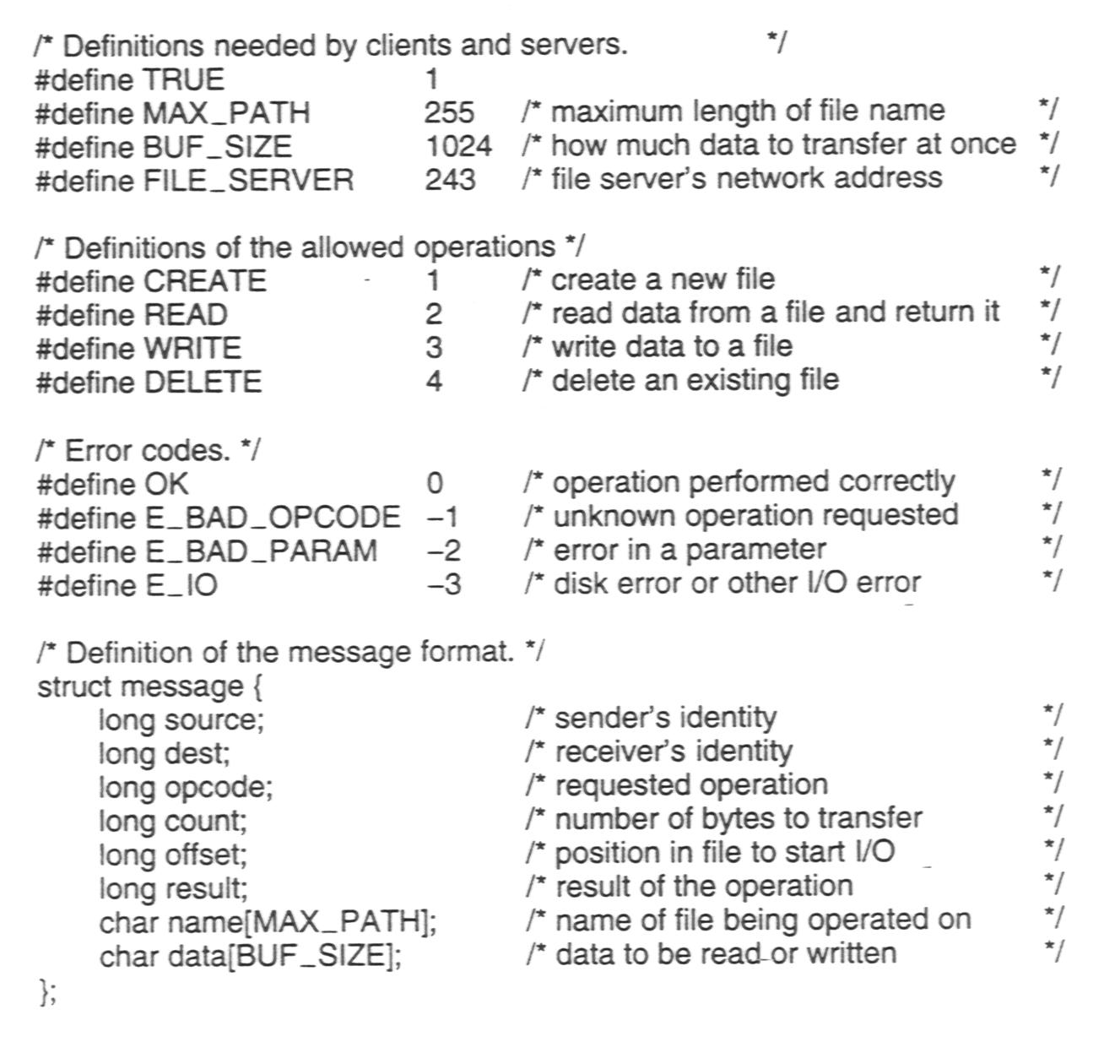
An Example Client and Server (1)
The header.h file used by the client and server

Slide 32
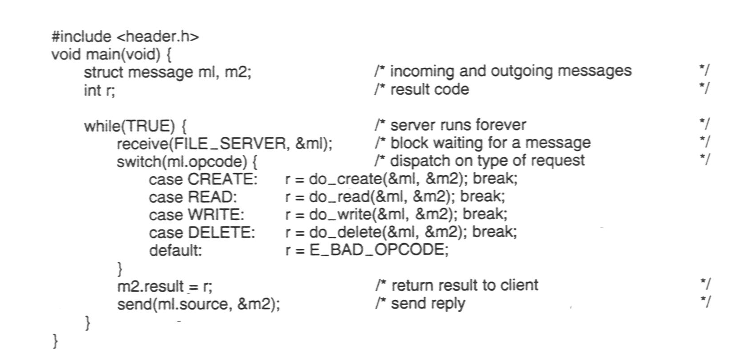
An Example Client and Server (2)
A sample server

Slide 33
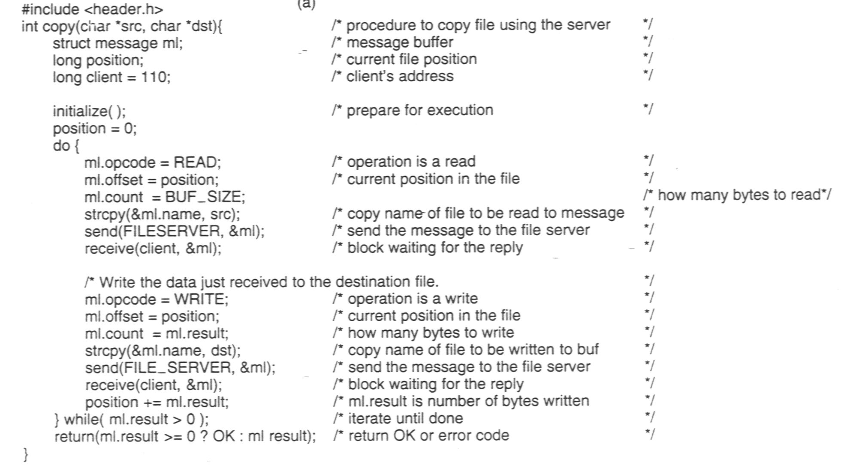
An Example Client and Server (3)
1-27 b
A client using the server to copy a file

Slide 34
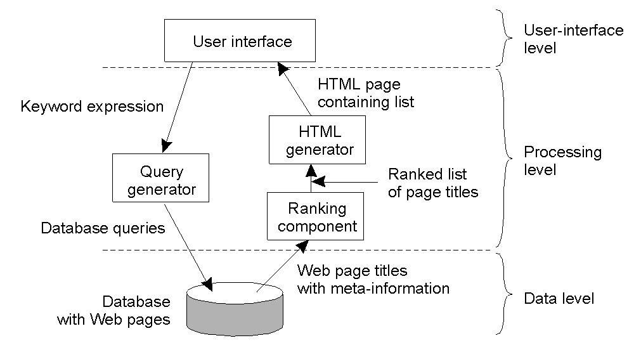
Processing Level
1-28
The general organization of an Internet search engine into three different layers

Slide 35
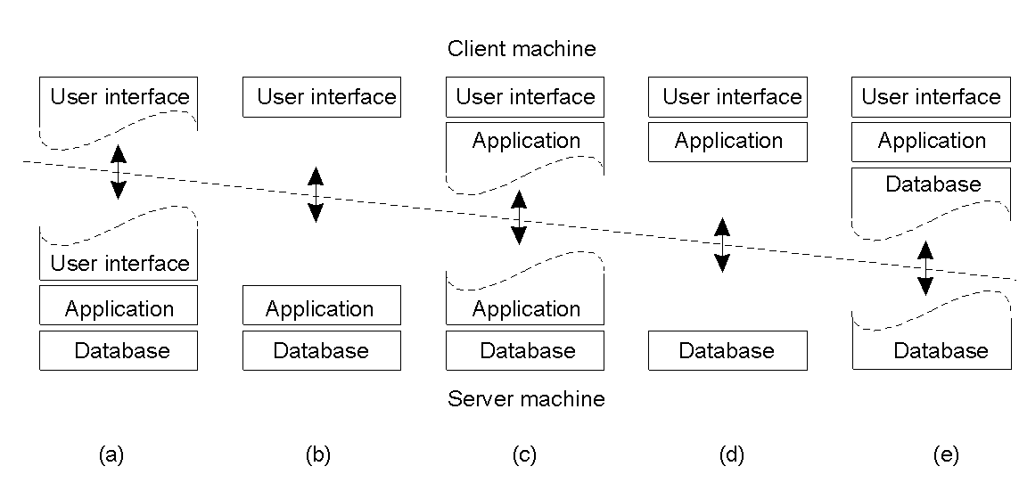
Multitiered Architectures (1)
1-29
Alternative client-server organizations (a) – (e)

Slide 36
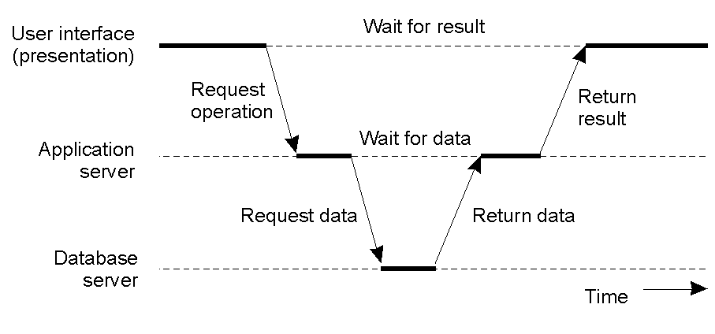
Multitiered Architectures (2)
1-30
An example of a server acting as a client

Slide 37
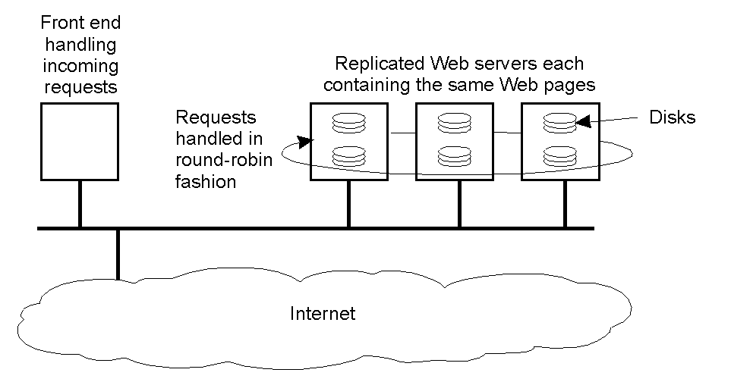
Modern Architectures
1-31
An example of horizontal distribution of a Web service

Slide 38
Thanks for Your Attention!

